Slide 1
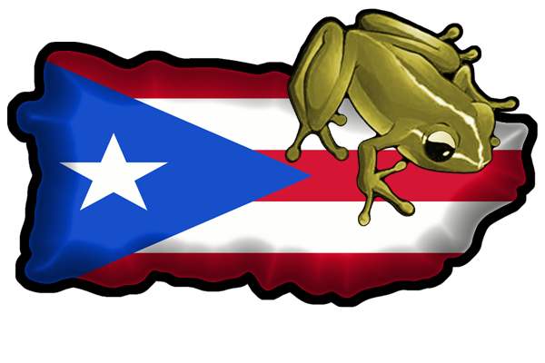
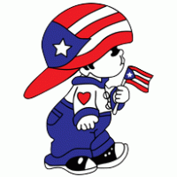
Puerto Rico
By alex

Slide 2
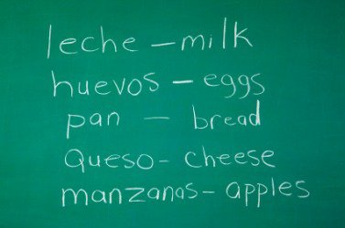
Language
The language they speak is Spanish.

Slide 3
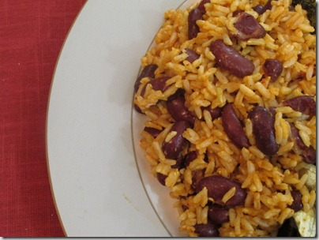
food
Aso pao with shrimp and vegetables and Traditonal chicharrones de pollo fried chicken.
The food that I like is rice and beans.

Slide 4
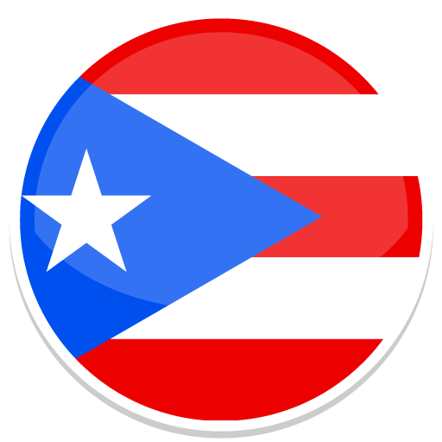
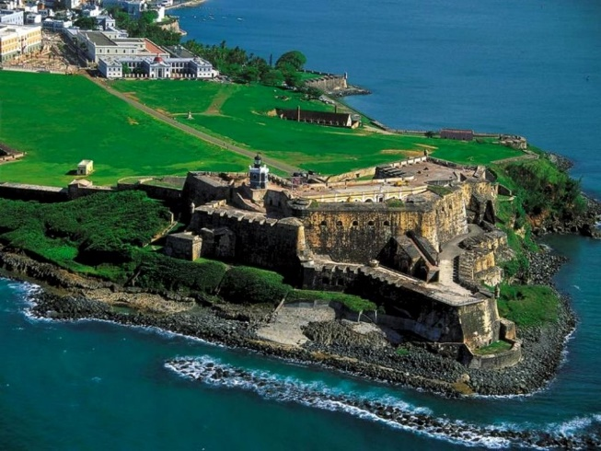
Cities in Puerto Rico
My dad is from Bayamon and my mom is from Juana Diaz and I like it.

Slide 5
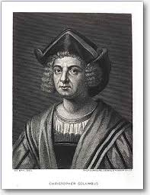
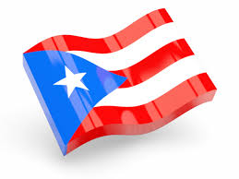
History of Puerto Rico
History of Puerto Rico
On November 19,1493 Puerto Rico was discovered
by Christopher Columbus on his second voyage. To claim lands for the rulers of Spain king Ferdinand and queen Isabella. In 1493 the island was called Boringuen by the Indians who lived there.

Slide 6
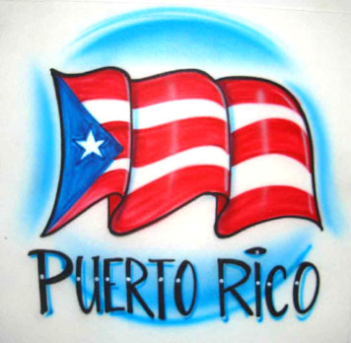
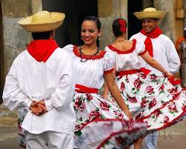
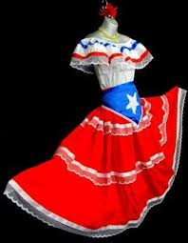
Traditions
Traditions Puerto Rican is predominantly Spanish in style having layers and heavy materials, such as wool.

Slide 7
A country I want to visit is the Ukraine
Cities in the Ukraine are Kiev and Odessa and livid Yalta and Pripyat
The language they speak is Ukrainian
Ukraine is a large country in eastern Europe known for its orthodox churches black sea coastline and forested mountains.
Sports such as football and wrestling have been popular in Ukraine since the 19th century and the football is the most popular sport in Ukraine .

Slide 8
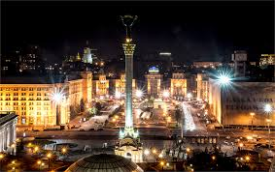
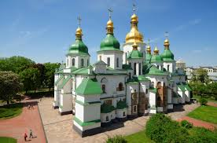
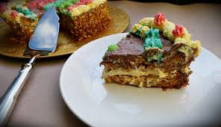
Ukraine

Slide 9
References
www.reference.com.
Thelatinkitchen.com
www.wiki.com
Welcome.topuertorico.

